Slide 1
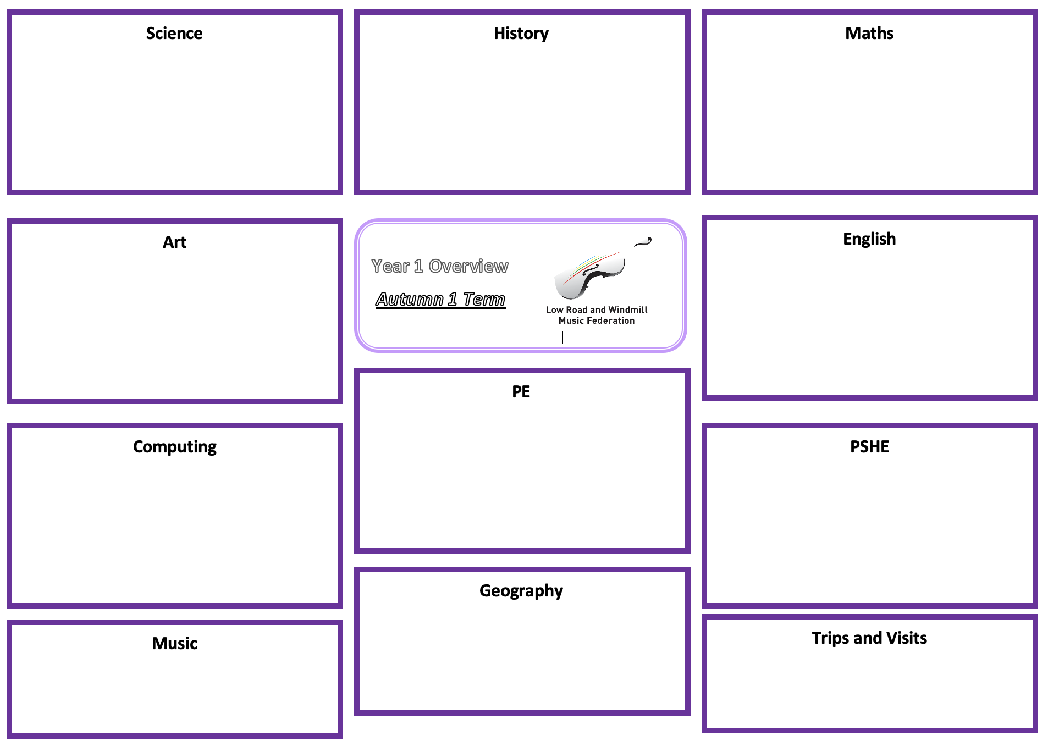
Science: Everyday Materials - Marvelous Materials
History: The Greatest Explorers
Maths: Place Value (within 50), Measurement Length and Height and Mass and Volume
Distinguish between an object and the material from which it is made
Identify and name a variety of everyday materials
Describe the simple physical properties of a variety of everyday materials
Compare and group together a variety of everyday materials based on physical properties
Asking simple questions and answering in different ways
Observing closely, using simple equipment
Performing simple tests
Identifying and classifying
Using their observations and ideas to suggest answers to questions
Gathering and recording data to help in answering questions
To learn about:
What explorers did in history and do now, and explain their achievements
The life and achievements of of Ibn Battuta, Captain Cook, Roald Amundsen, Sunita Williams and Captain Scott and why their travels were important
To consider who is the greatest explorer, and be able to explain their reasoning
To count from 20 to 50
To understand 20, 30, 40 and 50
To count by making groups of tens
To identify groups of tens and ones
To partition into tens and ones
To use the number line to 50 and estimate
To find one more and one less
To compare lengths and heights
To measure length using objects and centimeters
To recognise heavier and lighter
To measure and compare mass
To identify full and empty and compare volume
To measure and compare capacity
Art: Craft and Design
English:
To know that art can be made in different ways
To choose, measure, arrange and fix materials
To explore plaiting, threading and knotting techniques
To learn how to weave
To combine techniques in a woven artwork
Fiction: Fantasy Story
To write a character description
Non-fiction: Instructions
To write a set of instructions and then build following my instructions
Poetry: Songs and repetitive poems
To write a short repetitive poem
Spring 2
P.E: Gymnastics
To explore travelling movements using the space around you
To develop quality when performing gymnastic shapes
To develop stability and control when performing balances
To develop technique and control when performing shape jumps
To develop technique in the barrel, straight and forward roll.
To link gymnastic actions to create a sequence
Computing: Technology 1
PSHE: Drug, Alcohol and Tobacco Education – What do we put into, and on our bodies.
To evaluate and apply information technology, including new or unfamiliar technologies, analytically to solve problems
To be responsible, competent, confident and creative users of information and communication technology
To be able to use, and express themselves and develop their ideas through, information and communication technology – at a level suitable for the future workplace and as active participants in a digital world
To use various Apps for a range of purposes, creative output in multiple ways, how computers are used in the work place
To learn about different inventions throughout the last 200 years
To recognise that different things that go into bodies can make people feel good or not so good
To identify whether a substance might be harmful to take in
To know how to ask for help if they are unsure whether something should go into the body
To know that substances can be absorbed through the skin
To recognise that different things that people put on to bodies can make them feel good or not so good
To state some basic safety rules for things that go on to the body
Geography:
Music:
Trips and Visits:
To present rhythm names for a single sound - ta, and 2 sounds in every beat - ti-ti
To practice our rhymes with these new rhythm names
To learn what ta/and ti-ti look like written down, and read patterns with our teachers
To encourage the description of the music they listen to and perform, considering dynamics, speed and the overall mood of the music
Commences Summer 1

